Slide 1


TR-102 Four Week Internship Report
This report provides an overview of the key projects, feedback, and personal growth experienced during the four-week internship at ONIONDEV TECHNOLOGIES PVT LTD
by uddhav bhardwaj

Slide 2
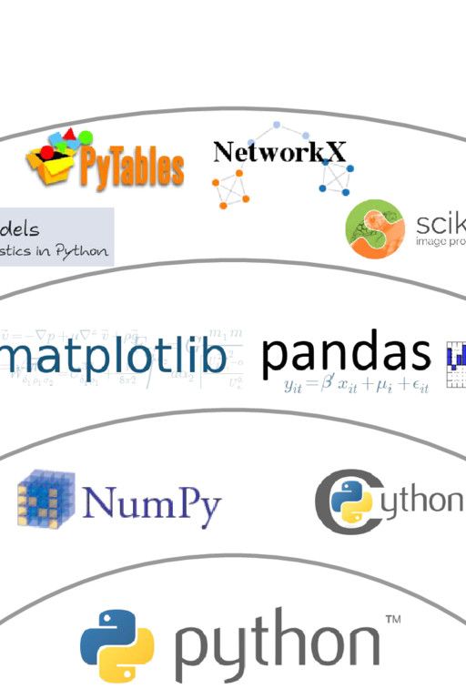
Overview of Internship Experience
1
Hands-on Learning
2
Collaborative Environment
The internship offered valuable opportunities to apply classroom knowledge to real-world challenges.
Working closely with a team of experienced professionals fostered a dynamic and supportive learning environment.
3
Multifaceted Projects
The internship involved a diverse range of projects, allowing for breadth and depth of exposure.

Slide 3
Summary of Key Projects Completed
3D JavaScript Prototype
EDA of Census Data
Community Risk Analysis
Developed an interactive 3D web application using JavaScript and WebGL technologies.
Performed exploratory data analysis on a large census dataset to uncover insights.
Conducted a comprehensive analysis of risk factors in a local community using GIS tools.

Slide 4
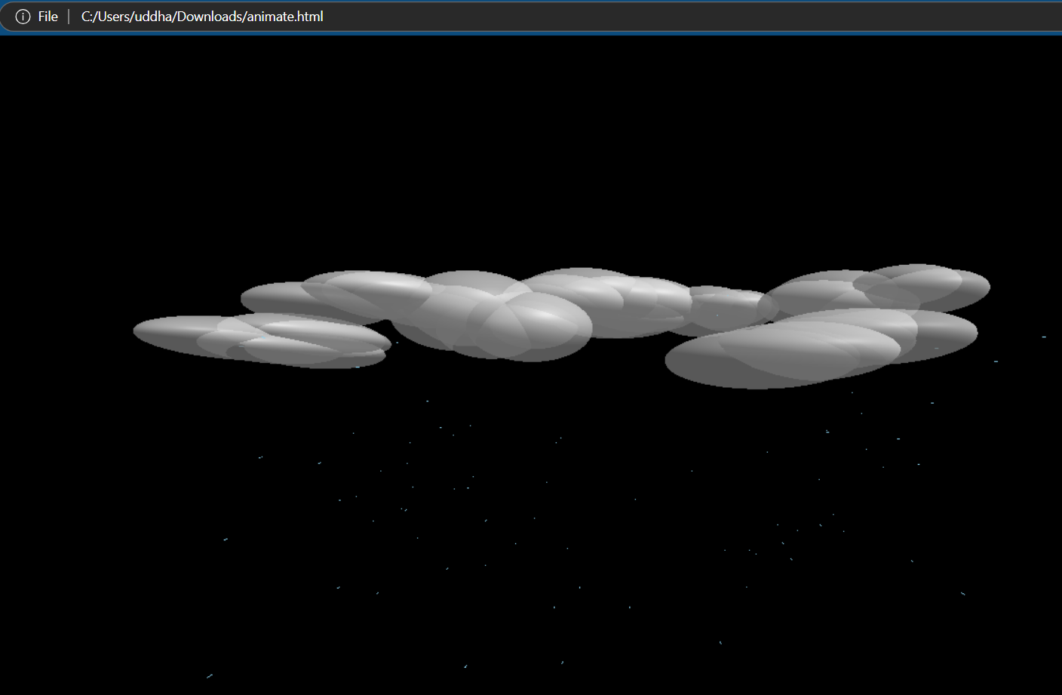
3D JAVASCRIPT PROTOTYPE ( ANIMATE.HTML )
1
Concept Development
Brainstormed and designed an interactive 3D experience to showcase the company's services.
2
WebGL Implementation
Utilized WebGL and Three.js libraries to build the dynamic 3D visualization.
3
User Interactivity
Incorporated controls and animations to allow users to explore the 3D environment.

Slide 5
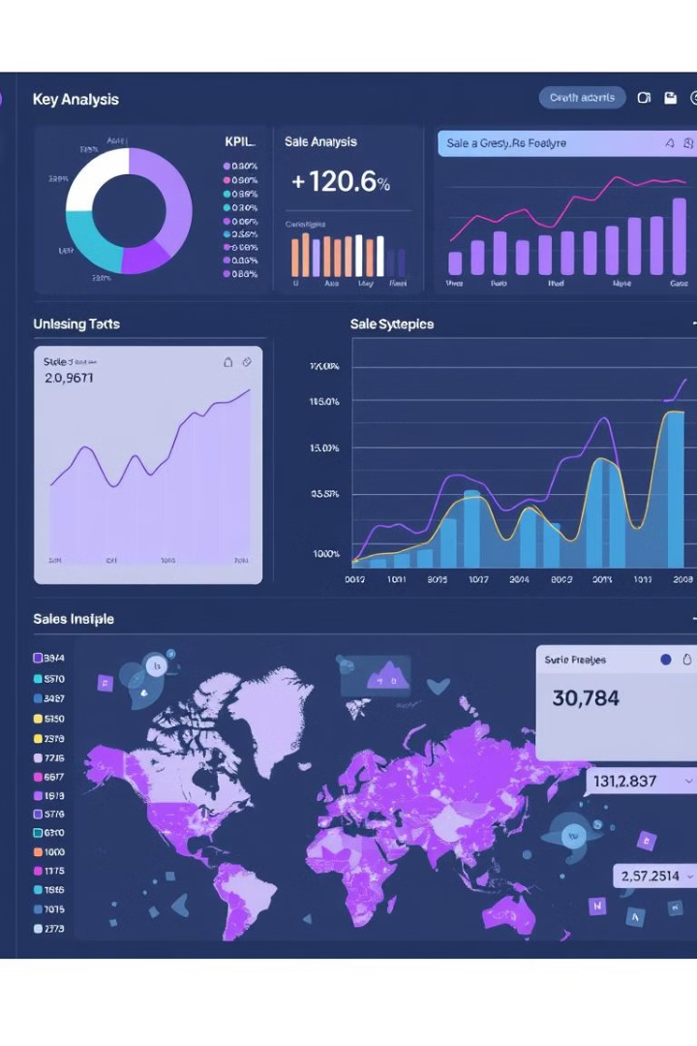
EDA OF CENSUS DATA
Data Cleaning
Exploratory Analysis
Performed thorough data cleaning and preprocessing to ensure the dataset was ready for analysis.
Utilized various statistical and visual techniques to uncover patterns and insights in the data.
Reporting and Presentation
Synthesized findings into a comprehensive report and presented key takeaways to stakeholders.

Slide 6
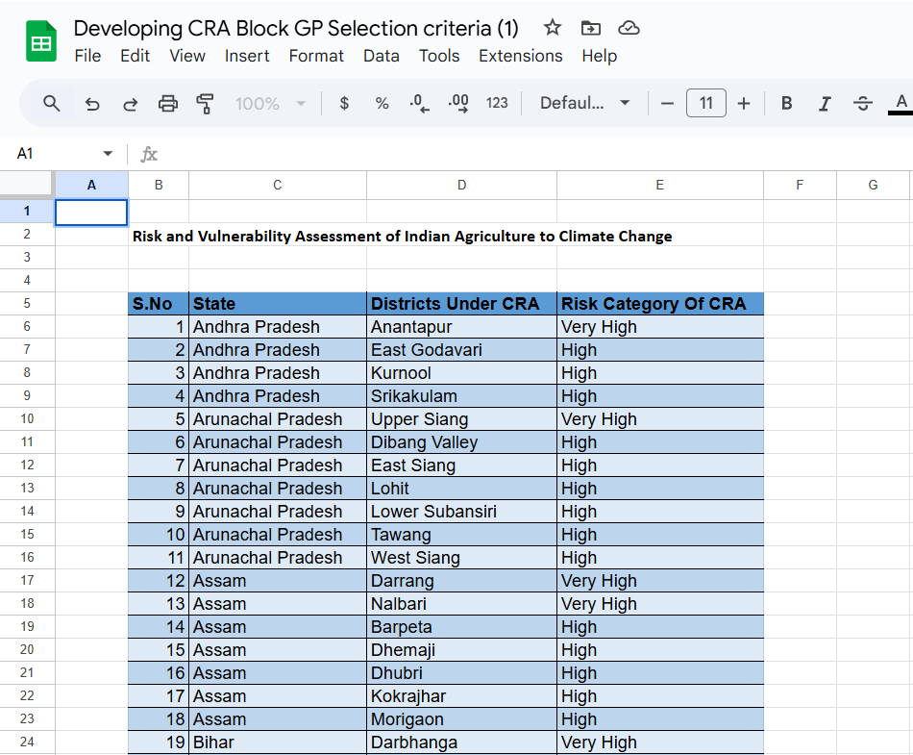



COMMUNITY RISK
ANALYSIS
Geographic Mapping
Leveraged GIS tools to create detailed maps
of the community and its risk factors.
Data-Driven Insights
Analyzed demographic, environmental,
and infrastructure data to identify
high-risk areas.
Recommendations
Proposed targeted interventions and
strategies to mitigate the identified risks.

Slide 7
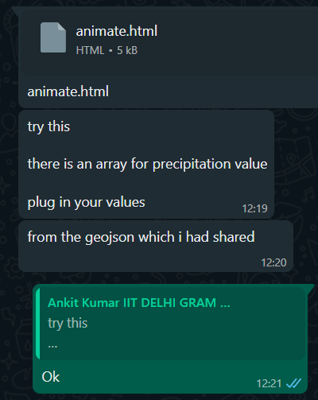



Feedback and Mentorship Received
Constructive Feedback
Regular check-ins and feedback sessions helped refine my skills and approach.
Personalized Guidance
My mentor provided valuable insights and advice to support my professional development.
Collaborative Learning
The mentorship experience fostered an environment of mutual growth and learning.

Slide 8

Impact on Personal and Professional Growth
Skill Development
1
The internship allowed me to enhance my technical, analytical, and problem-solving skills.
2
Confidence Building
Tackling real-world challenges boosted my self-assurance and ability to take on new tasks.
Career Exploration
3
The diverse projects and mentorship helped me gain clarity on my career aspirations.

Slide 9
Appreciation for Company Culture and Values
Collaborative Environment
Commitment to Innovation
Inclusive and Diverse
The company's emphasis on teamwork and open communication fostered a highly productive and supportive work culture.
The company's dedication to staying at the forefront of technology and continuously improving its offerings was inspiring.
The internship experience highlighted the company's commitment to fostering a diverse and inclusive workplace.

Slide 10
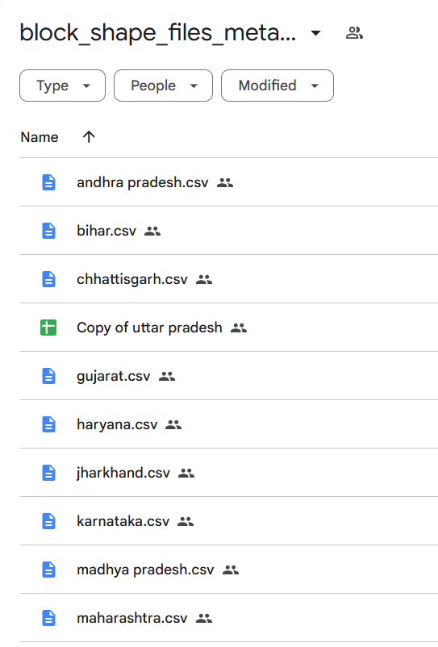
Conclusion and Next Steps
1
Invaluable Experience
2
Continued Growth
The internship provided an exceptional learning opportunity and a strong foundation for my future career.
I am grateful for the mentorship and feedback received, which will guide my ongoing professional development.
3
Aspirations
I am excited to explore further opportunities to apply the skills and knowledge gained during this internship.

